Slide 1
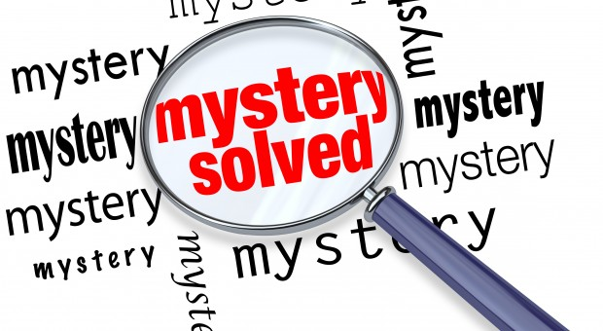
Characteristics of a Detective Story
A good detective story generally follows six “unwritten rules.”

Slide 2
C. Hugh Holman’s A Handbook to Literature defines a detective story as “a novel or short story in which a crime, usually a murder – the identity of the perpetrator unknown – is solved by a detective through a logical assembling and interpretation of palpable evidence, known as clues.”

Slide 3
First, the crime must be significant, worthy of the attention it receives. Most stories involve murder, though Conan Doyle tied the majority of his crimes to greed and theft.

Slide 4
Second, the detective must be in some way a memorable character. He or she must be very intelligent, of course, unusually clever and observant, but also quirky, possessing perhaps some idiosyncrasies that distinguish him or her.

Slide 5
Third, along with an exceptional detective, there must be an outstanding opponent, a criminal clever enough to be a match for the hero. Solving the crime can’t be too easy.

Slide 6
Fourth, because a large part of the attraction of a detective story is the opportunity for the reader to try to figure out the solution along with the detective, all suspects of the crime must be introduced early in the story.

Slide 7
Fifth, all clues the detective discovers must be made available to the reader also.

Slide 8
Finally, at the end of the story, the solution must seem obvious, logical, possible. The crime must not have resulted from accident or supernatural intervention, and the detective must be able to explain all aspects of the case in a reasonable way.

